Slide 1
Class Room Technical Problem Solving
Supervised by
Mr.Md Fahad Bin Zamal
Assistant professor
Department of Software Engineering
Daffodil International University
Presented by
MD.Zahid Alam
181-35-2458
Department of Software Engineering
Daffodil International University

Slide 2
Why need Class Room Technical Problem Solving
We have a lot of problems in our classroom like AC dose not work properly.
Fan dose not work properly.
Mouse is broken.
Keyboard dose not work properly.
Remote is not battery.
Table and chair is broken.
Computer dose not work properly.
Lights are broken, white board is broken.
WiFi network dose not work properly, window screen is broken. We can easily solve problems with this technology.

Slide 3
Overview
Teachers and students have many problems in the classroom such as AC dose not work, fan dose not work.
mouse is broken, keyboard dose not working.
Remote is not battery, table and chair is broken, computer dose not work.
light is broken, white board is broken, wifi network dose not working, door lock problem. We can easily find solutions to these problems with this technology

Slide 4
Purpose
This website is easy to use to solve class problem.
Student will save time by using this website.
Problem that are not solved in the class for a long time will be solved easily in a short time through this website.

Slide 5

Stakeholders
Admin
Officer
Stakeholders
User

Slide 6
Functional requirements
> Login > Registration >View profile >Modify profile >Send problem >Notification >Check problem >Send Feedback >Assign Technician > View Feedback >Manage Technician >Manage officer >Manage service >Manage Category > Logout

Slide 7
Non-functional requirements
Capacity.
Availability.
Reliability.
Recoverability.
Maintainability.
Serviceability.
Security.
Regulatory.
Manageability.
Data Integrity.
Usability.

Slide 8
Technology
Php Framework Laravel
Vue Js
Rest API
Technology
MySql Database

Slide 9
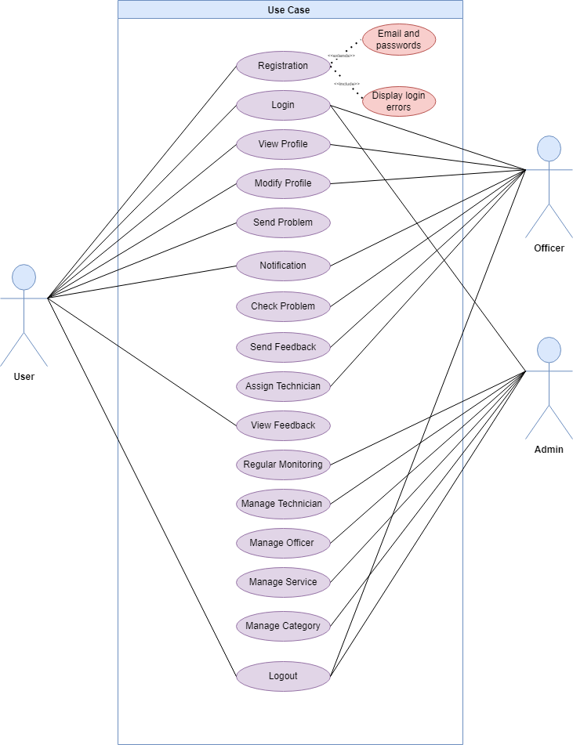
Use case

Slide 10
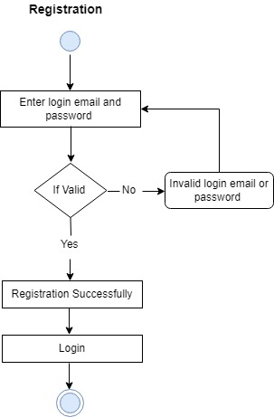
Activity diagram

Slide 11
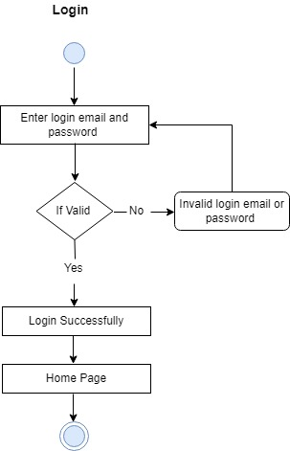
Activity diagram

Slide 12
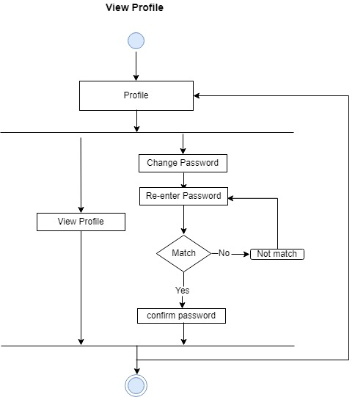
Activity diagram

Slide 13
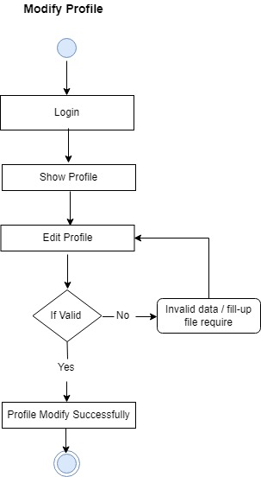
Activity diagram

Slide 14
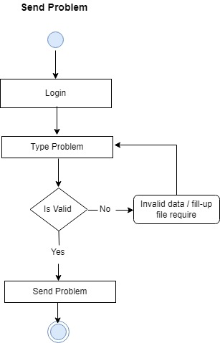
Activity diagram

Slide 15
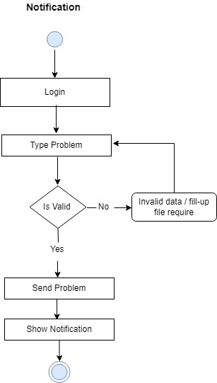
Activity diagram

Slide 16
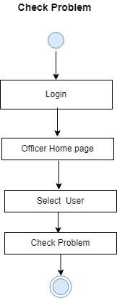
Activity diagram

Slide 17
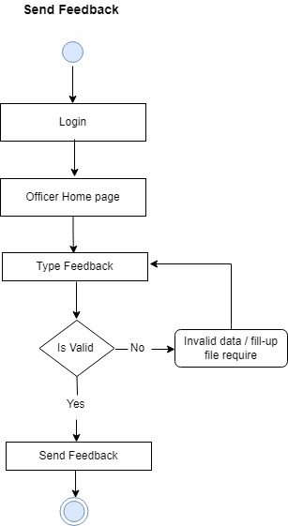
Activity diagram

Slide 18
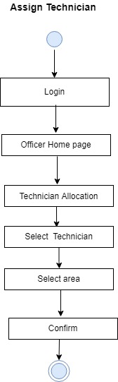
Activity diagram

Slide 19
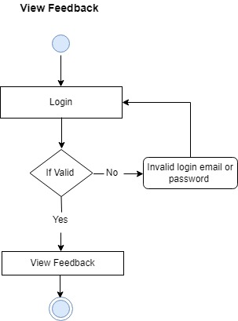
Activity diagram

Slide 20
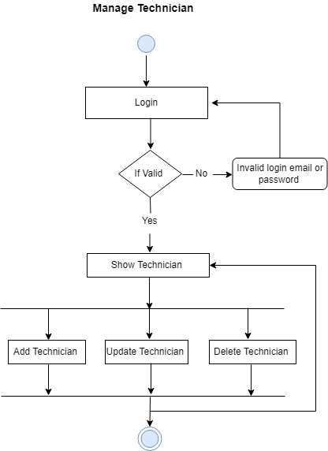
Activity diagram

Slide 21
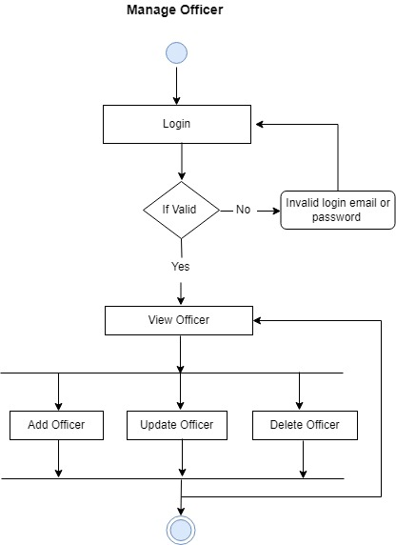
Activity diagram

Slide 22
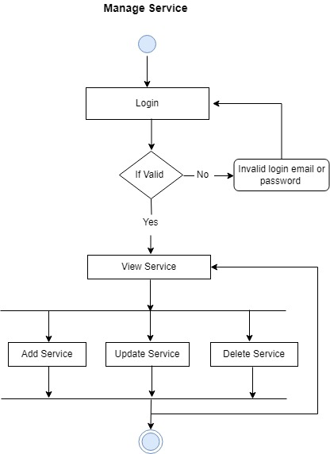
Activity diagram

Slide 23

Activity diagram

Slide 24
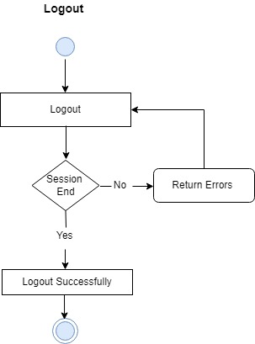
Activity diagram

Slide 25
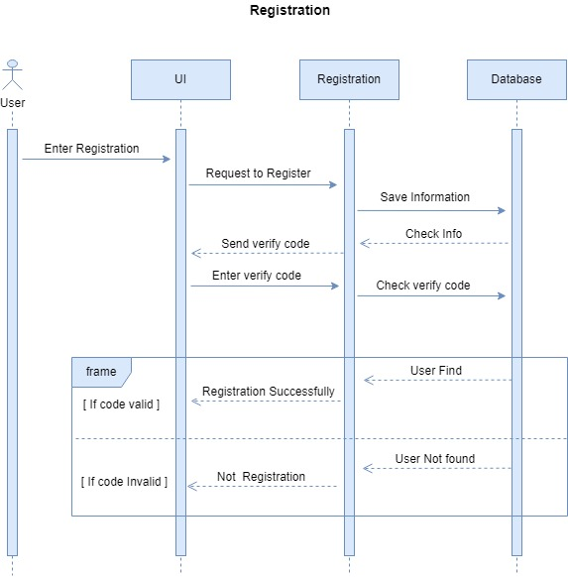
Sequence diagram

Slide 26
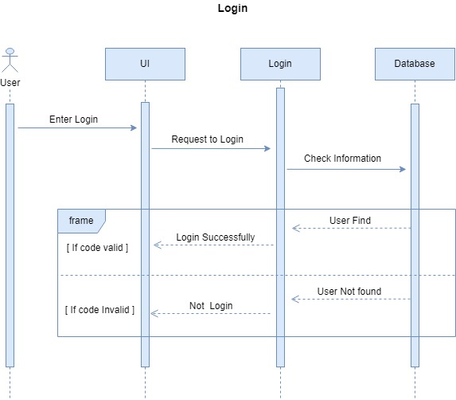

Slide 27
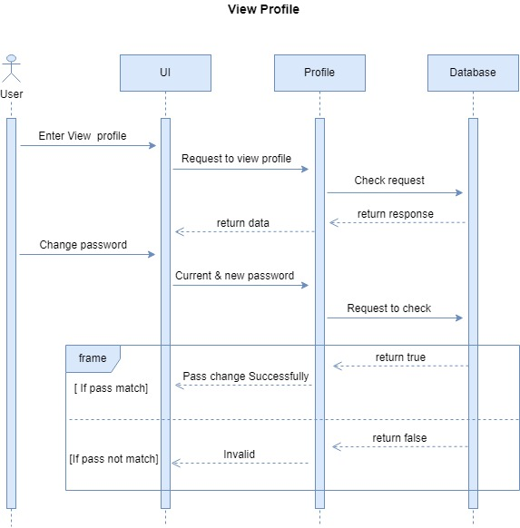

Slide 28
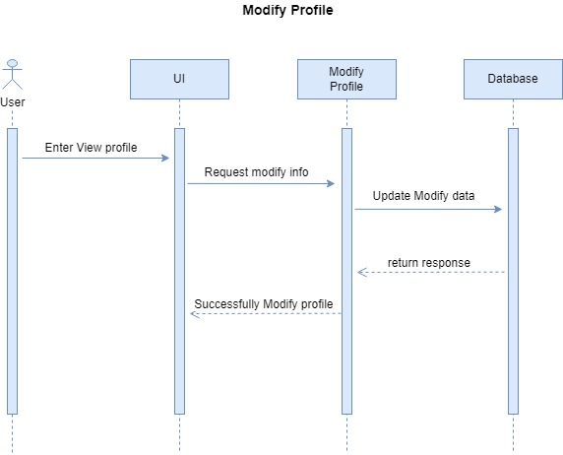

Slide 29
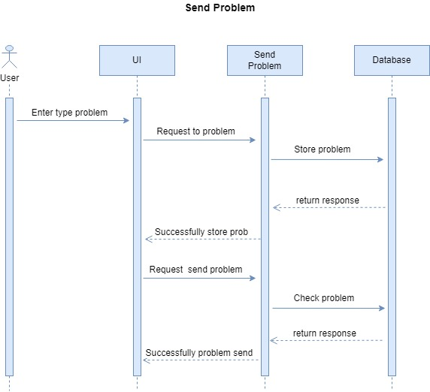

Slide 30
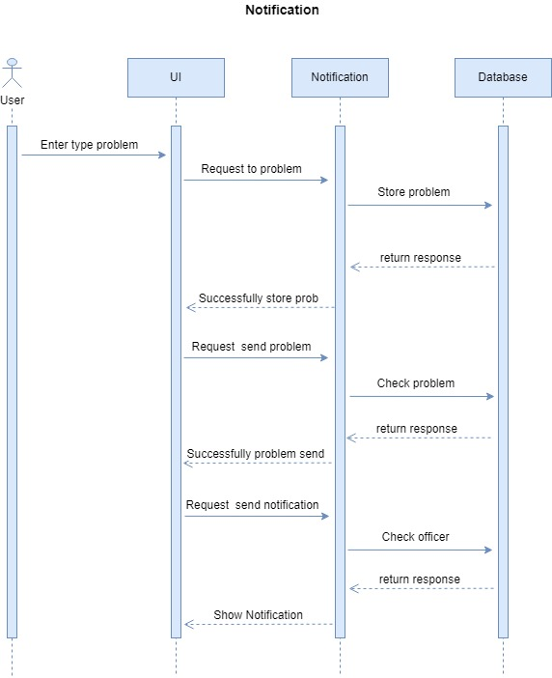

Slide 31


Slide 32
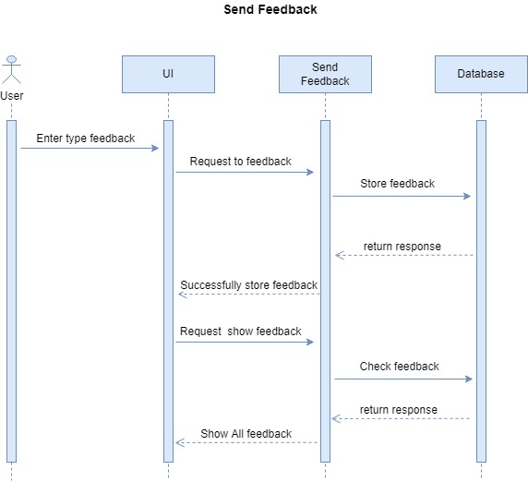

Slide 33
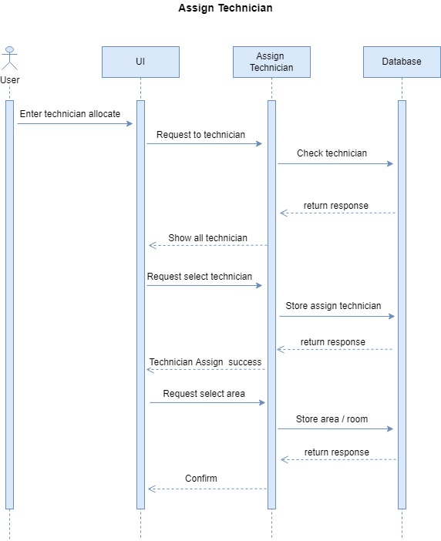

Slide 34


Slide 35
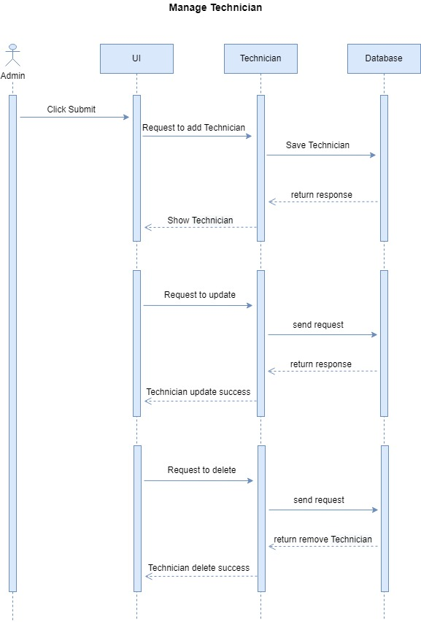

Slide 36
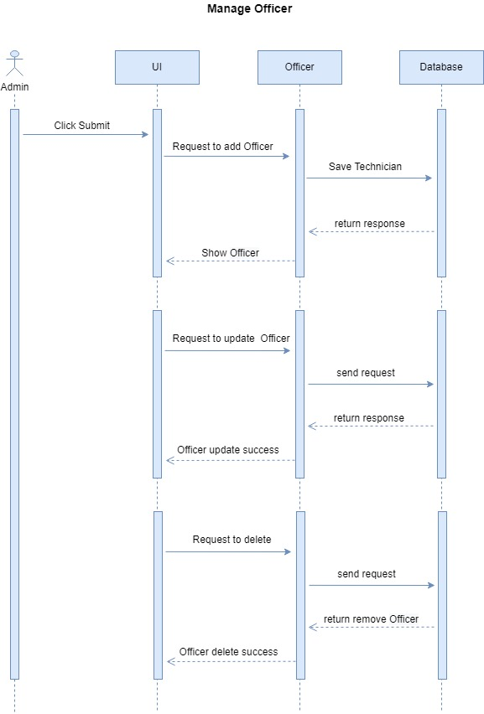

Slide 37
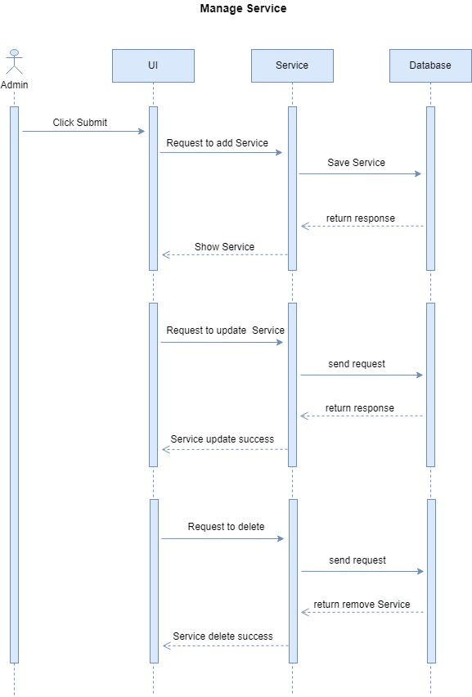

Slide 38


Slide 39
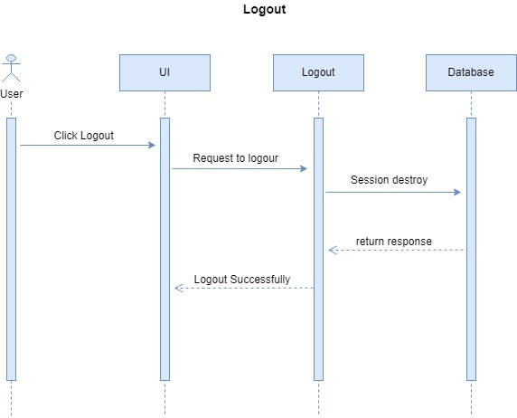

Slide 40
Entity Relationship Diagram

Slide 41
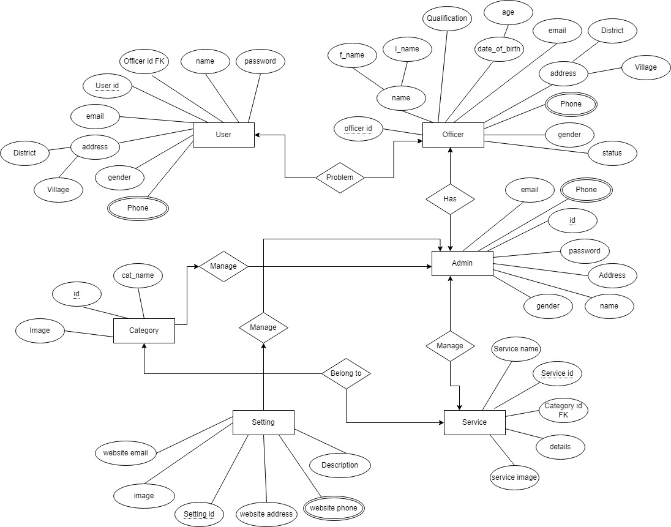

Slide 42
Project Screenshort

Slide 43
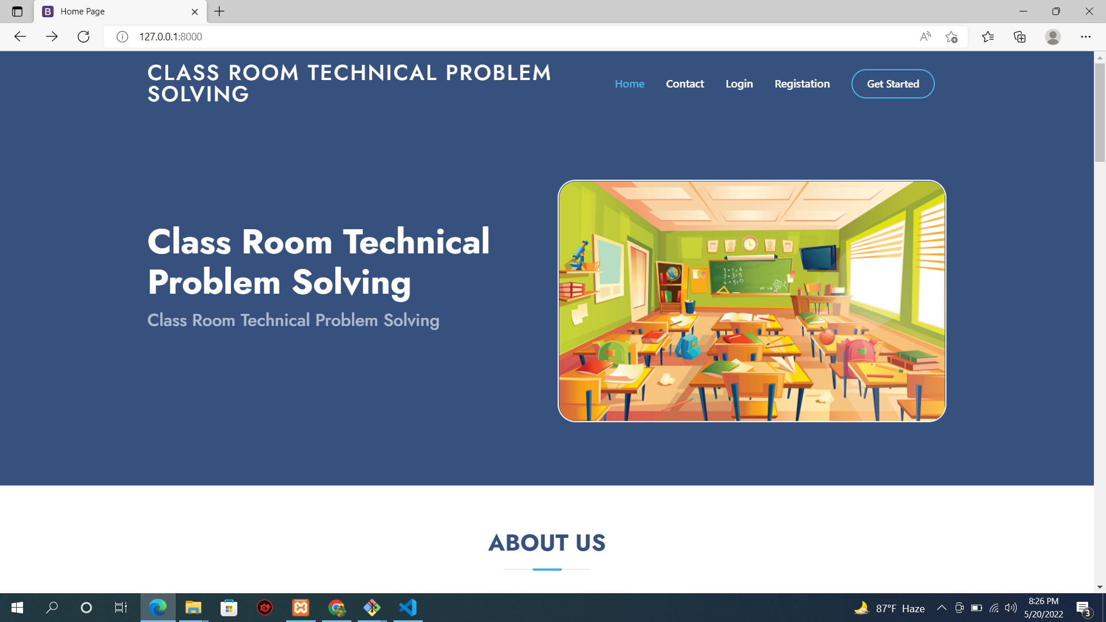

Slide 44
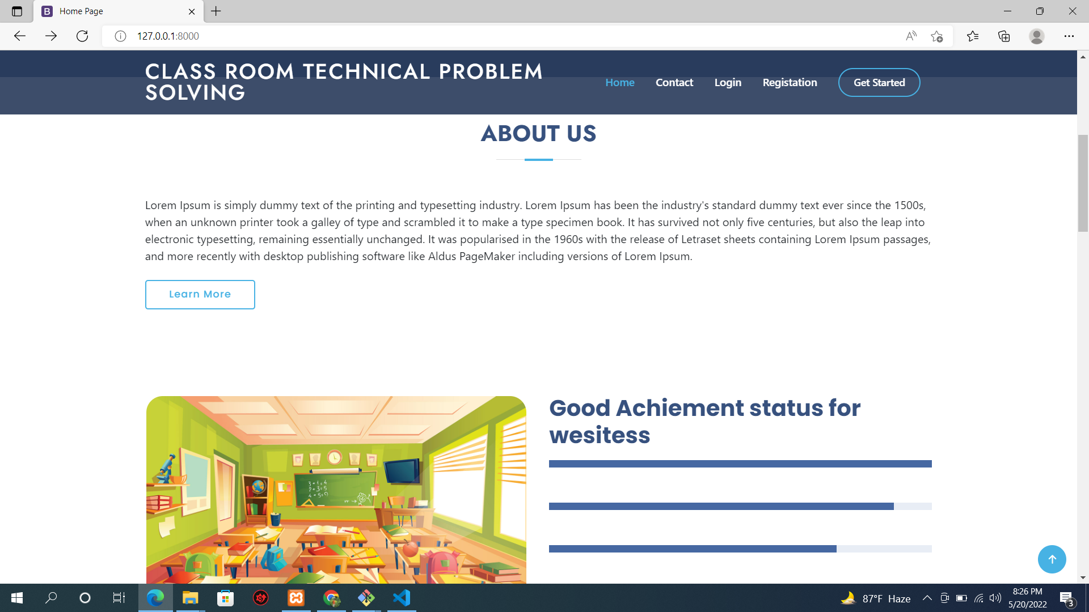

Slide 45
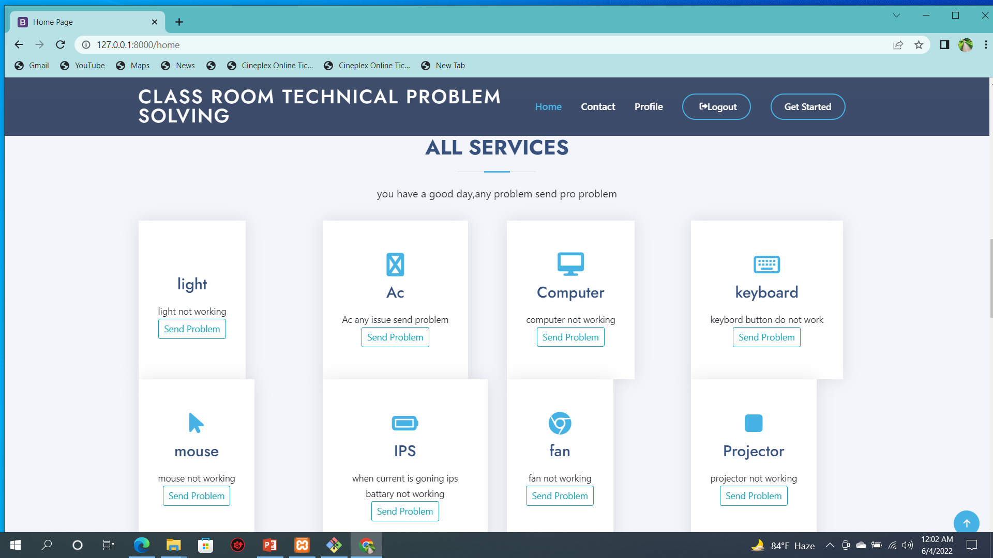

Slide 46
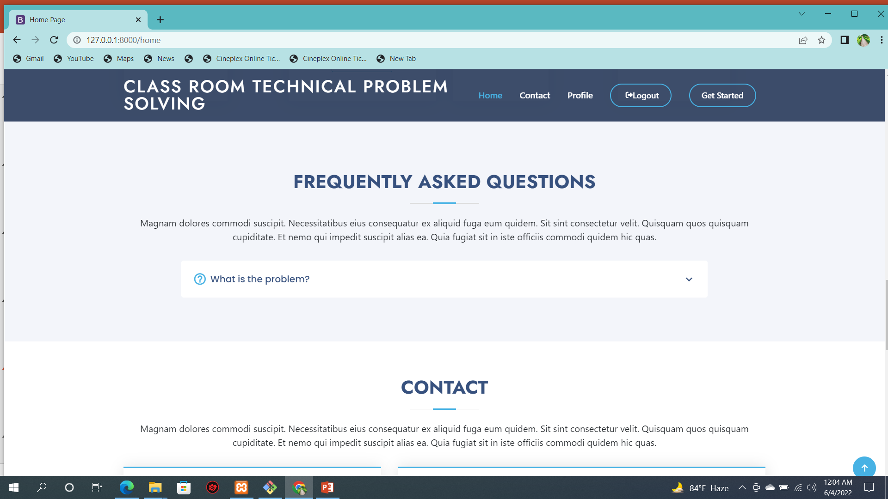

Slide 47
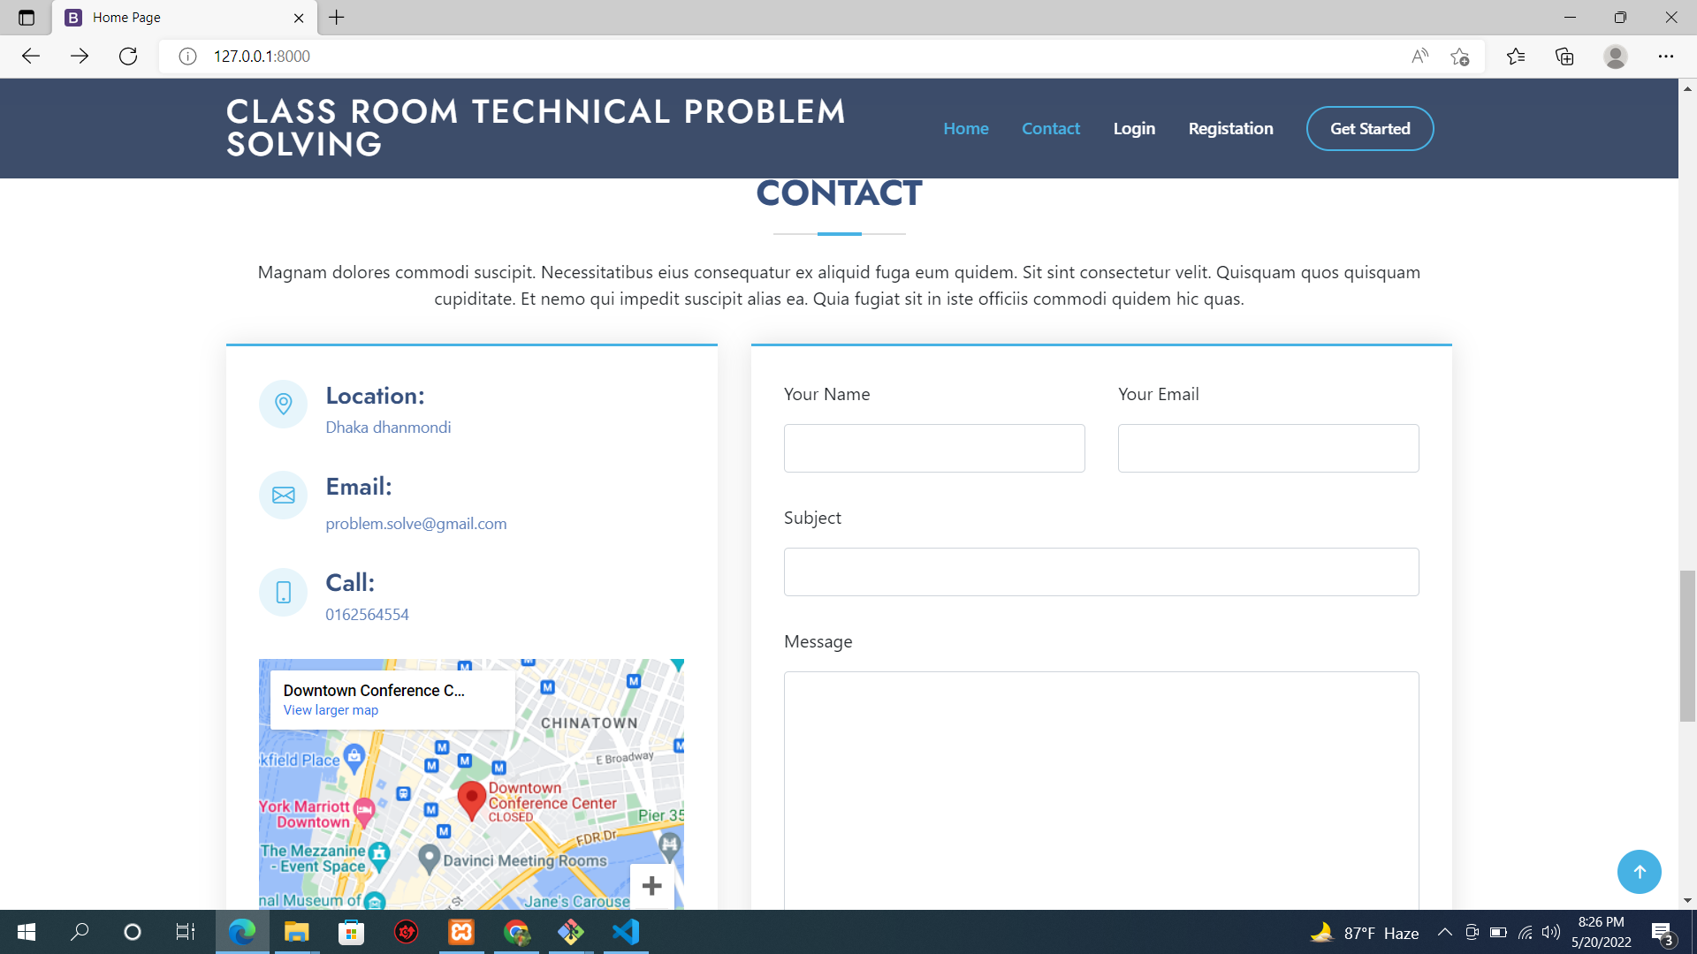

Slide 48
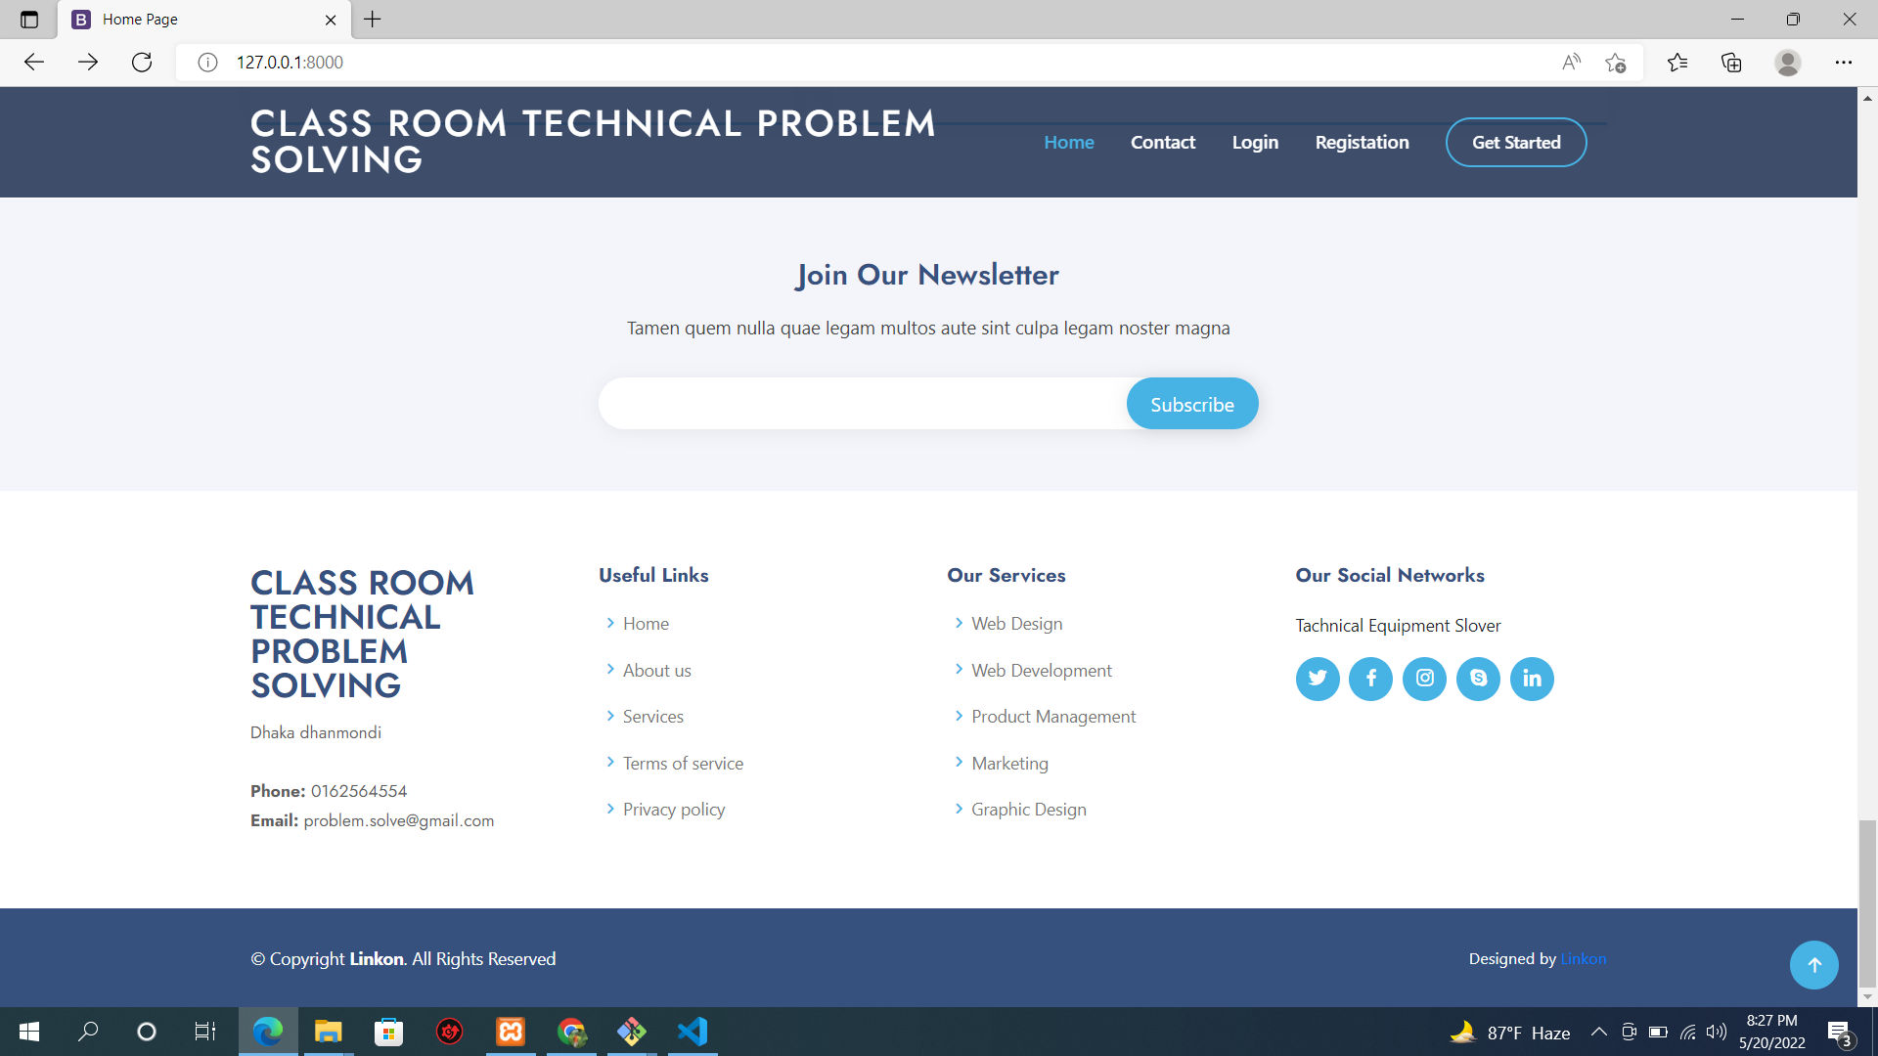

Slide 49
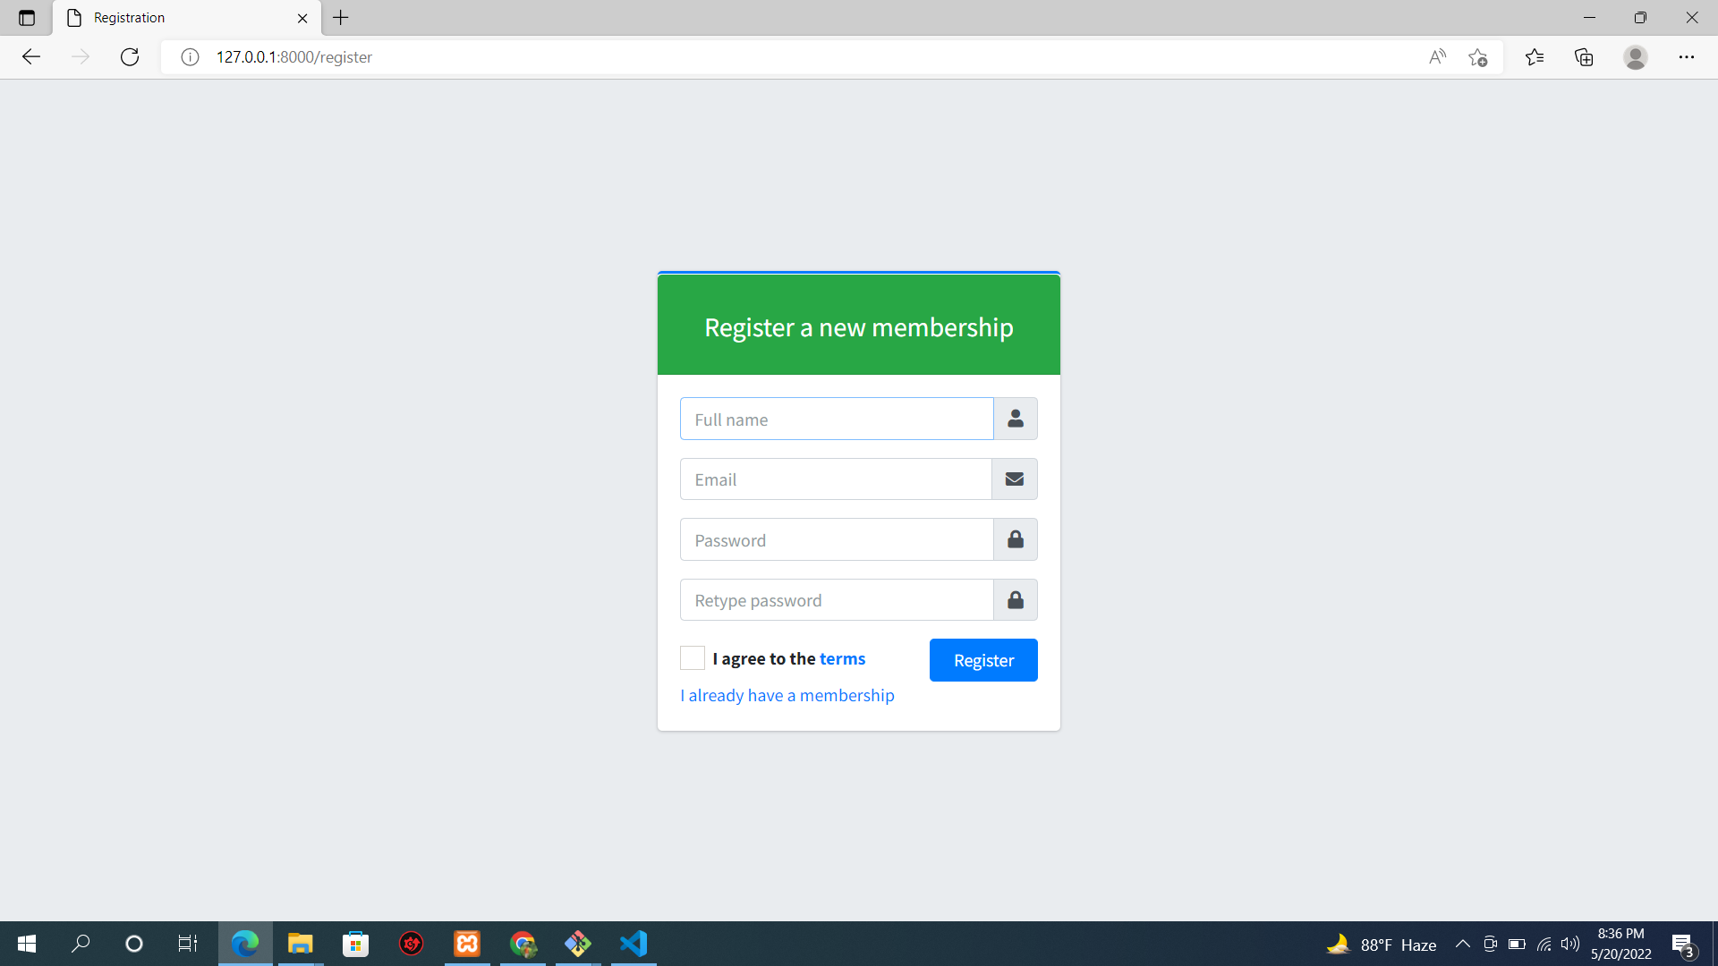

Slide 50
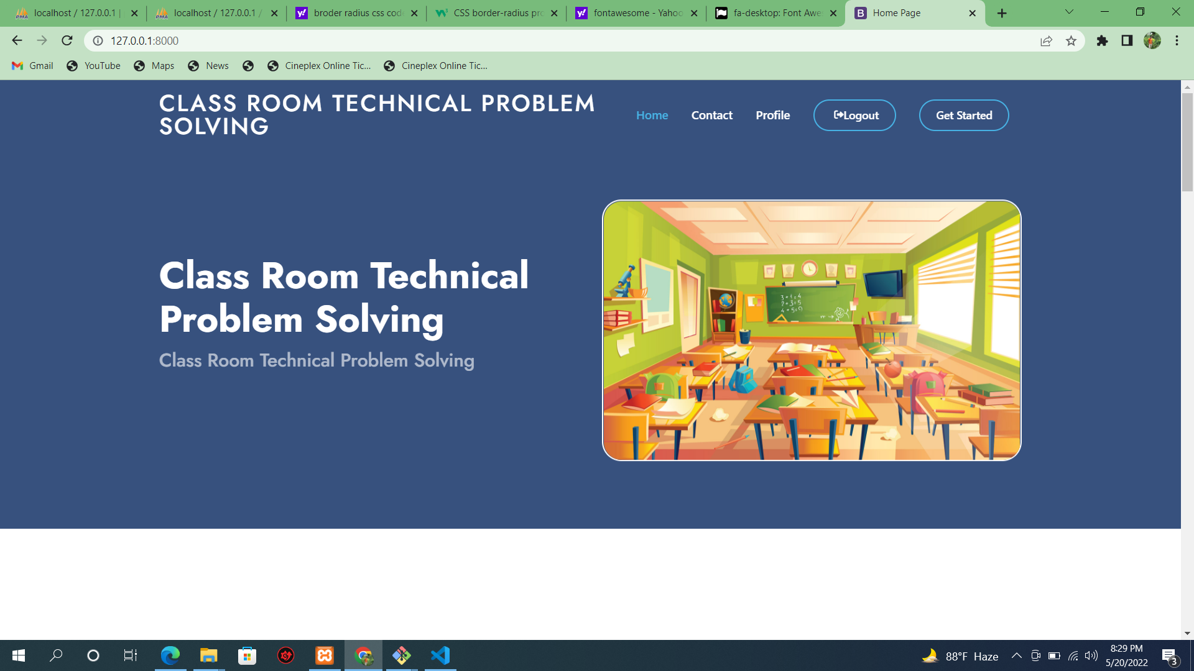

Slide 51
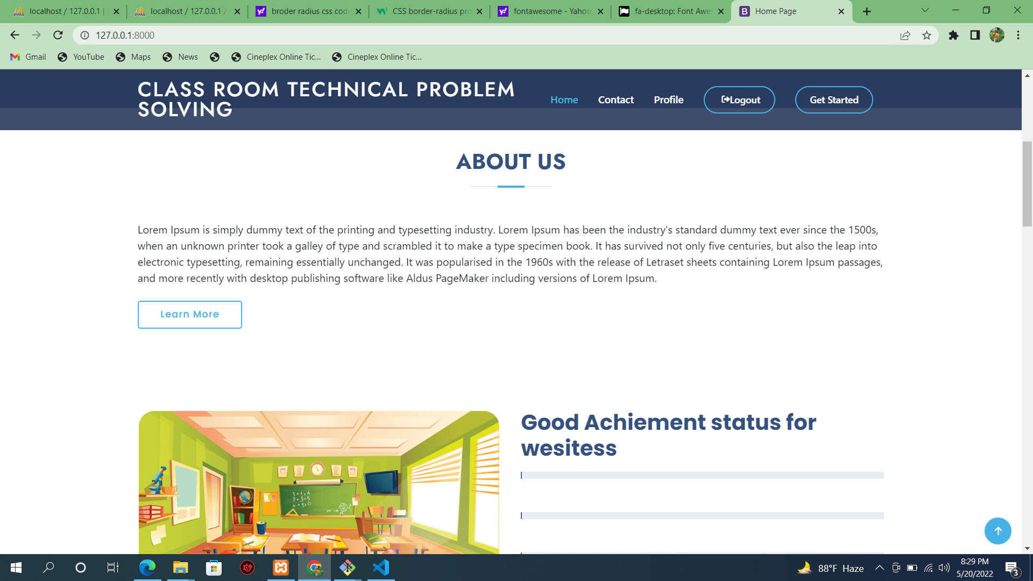

Slide 53
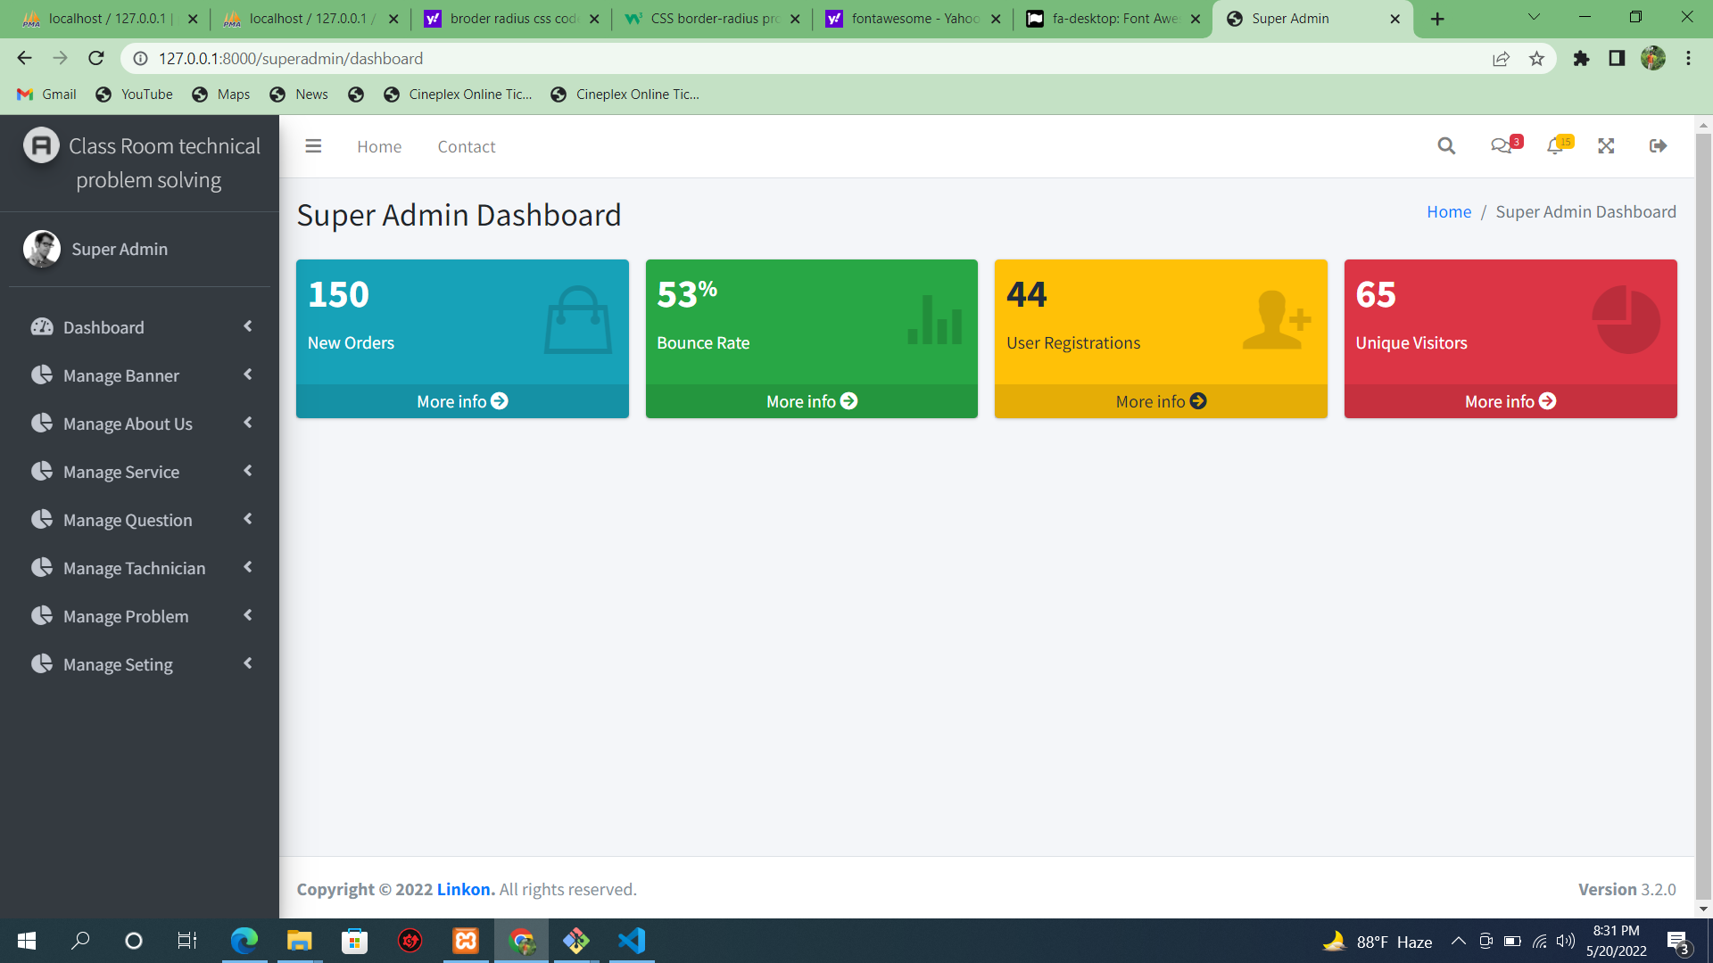

Slide 54
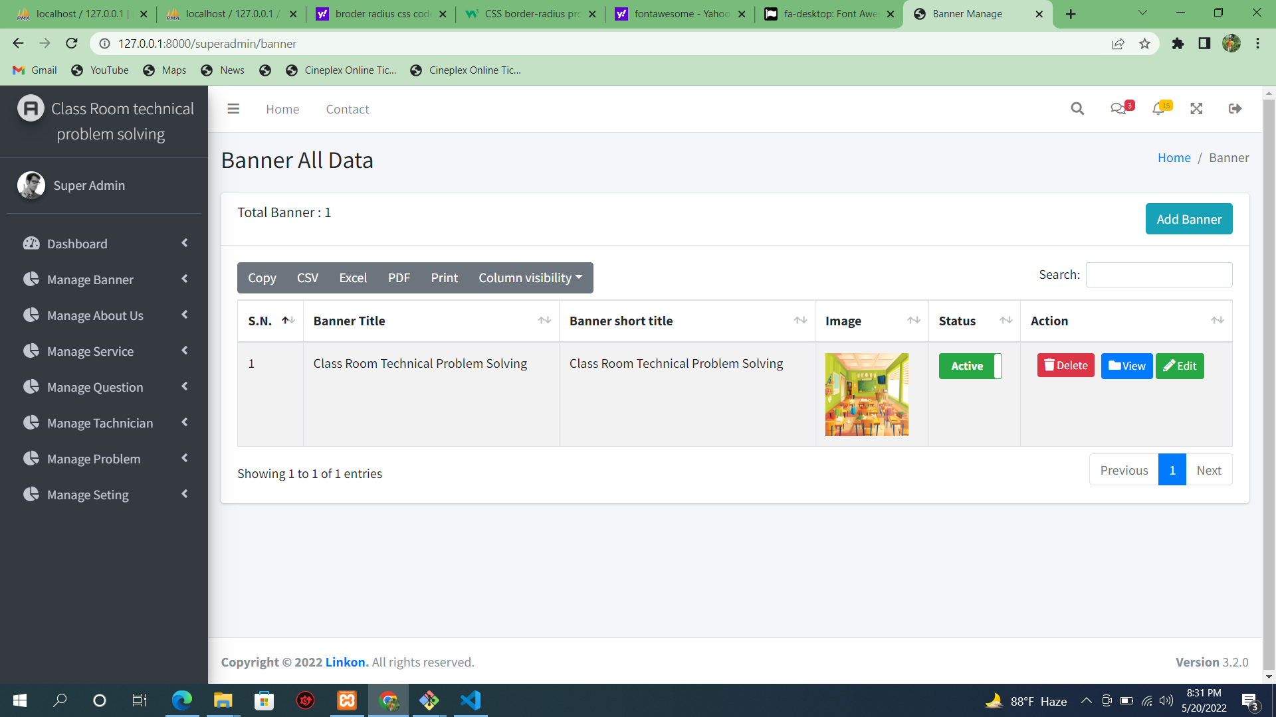

Slide 55
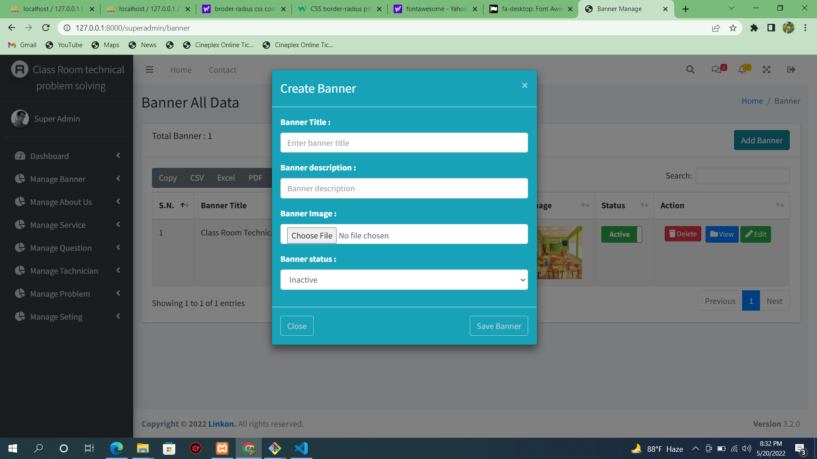

Slide 56
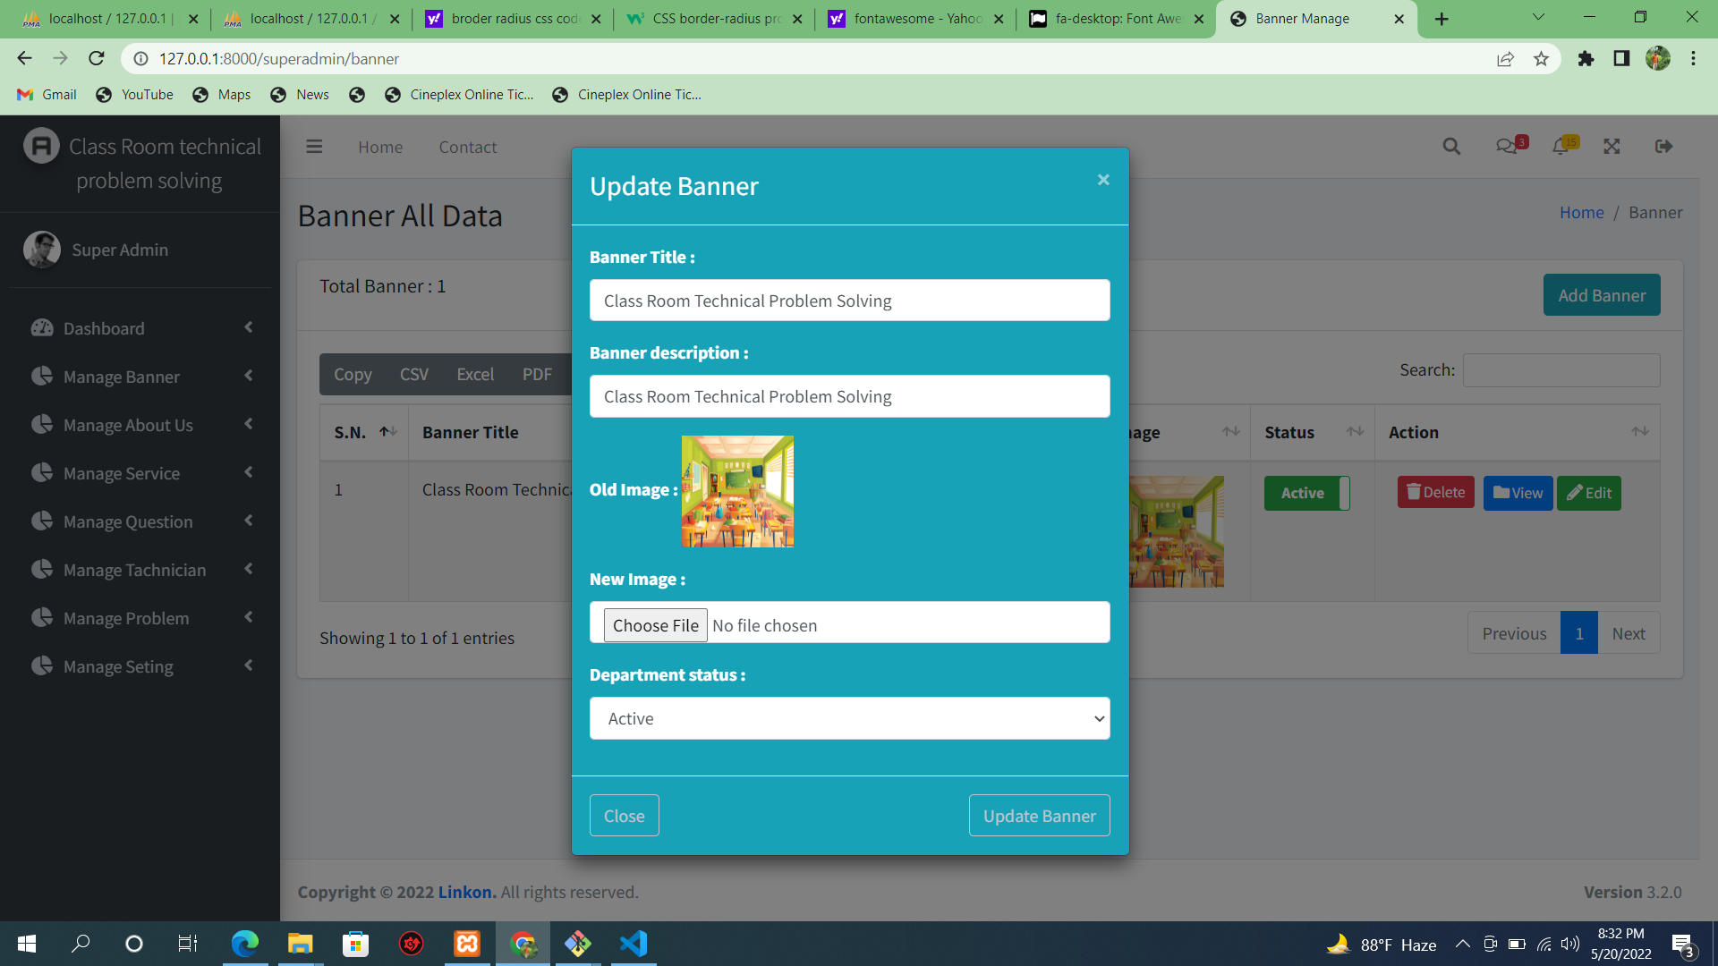

Slide 57
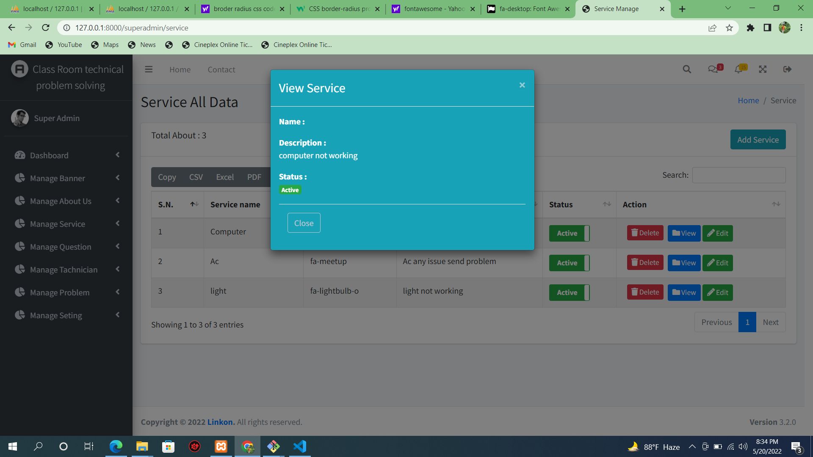

Slide 58
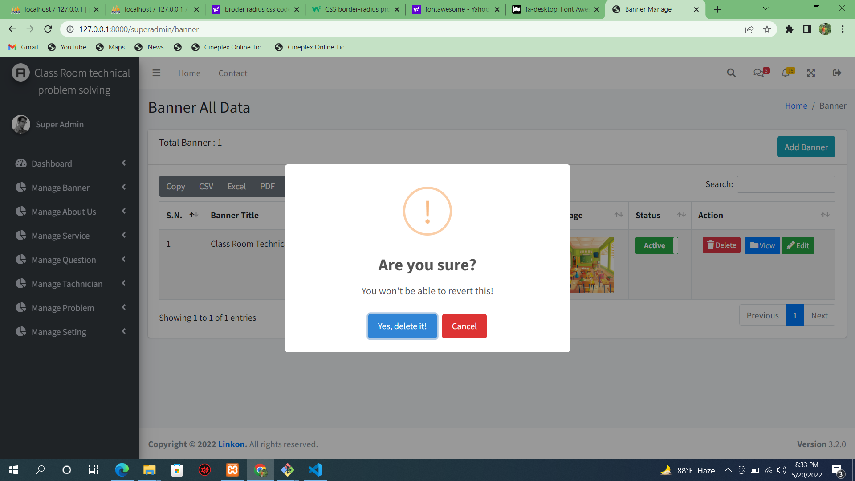

Slide 59
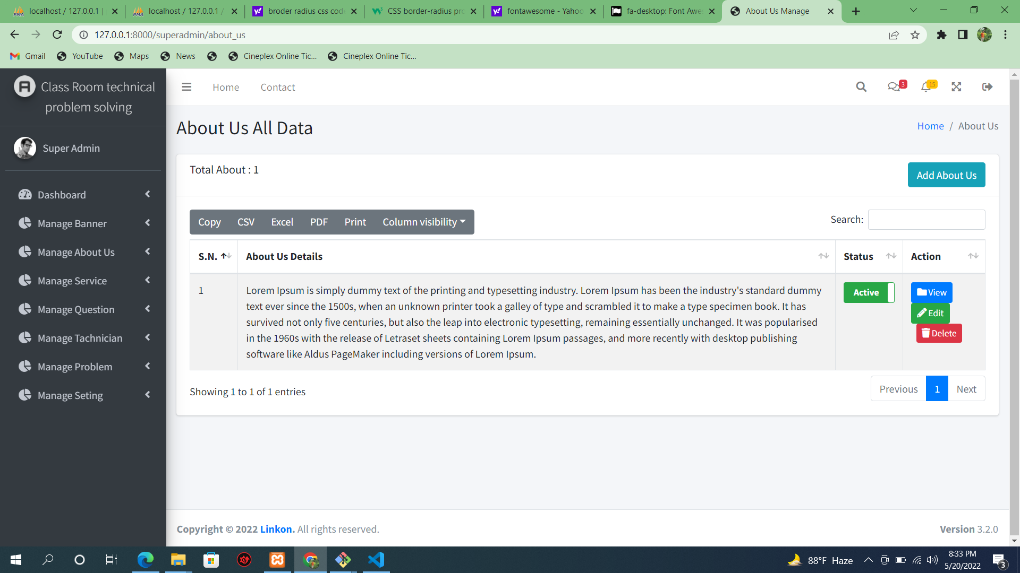

Slide 60
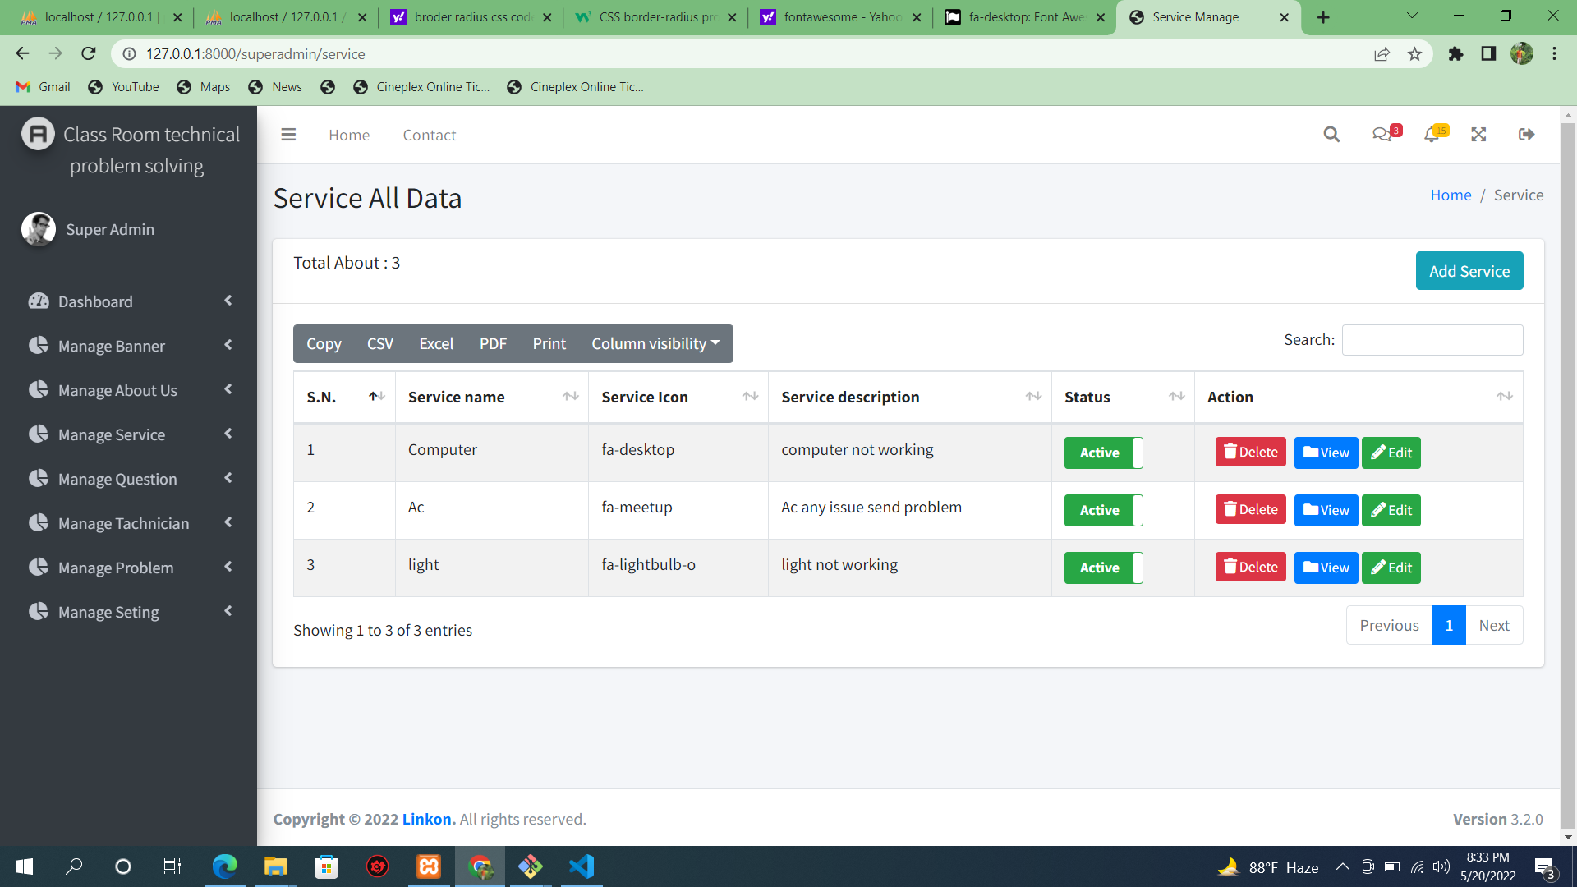

Slide 61
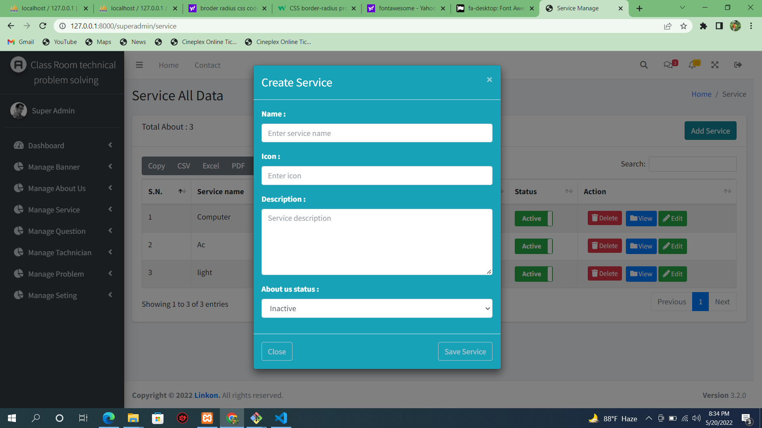

Slide 62
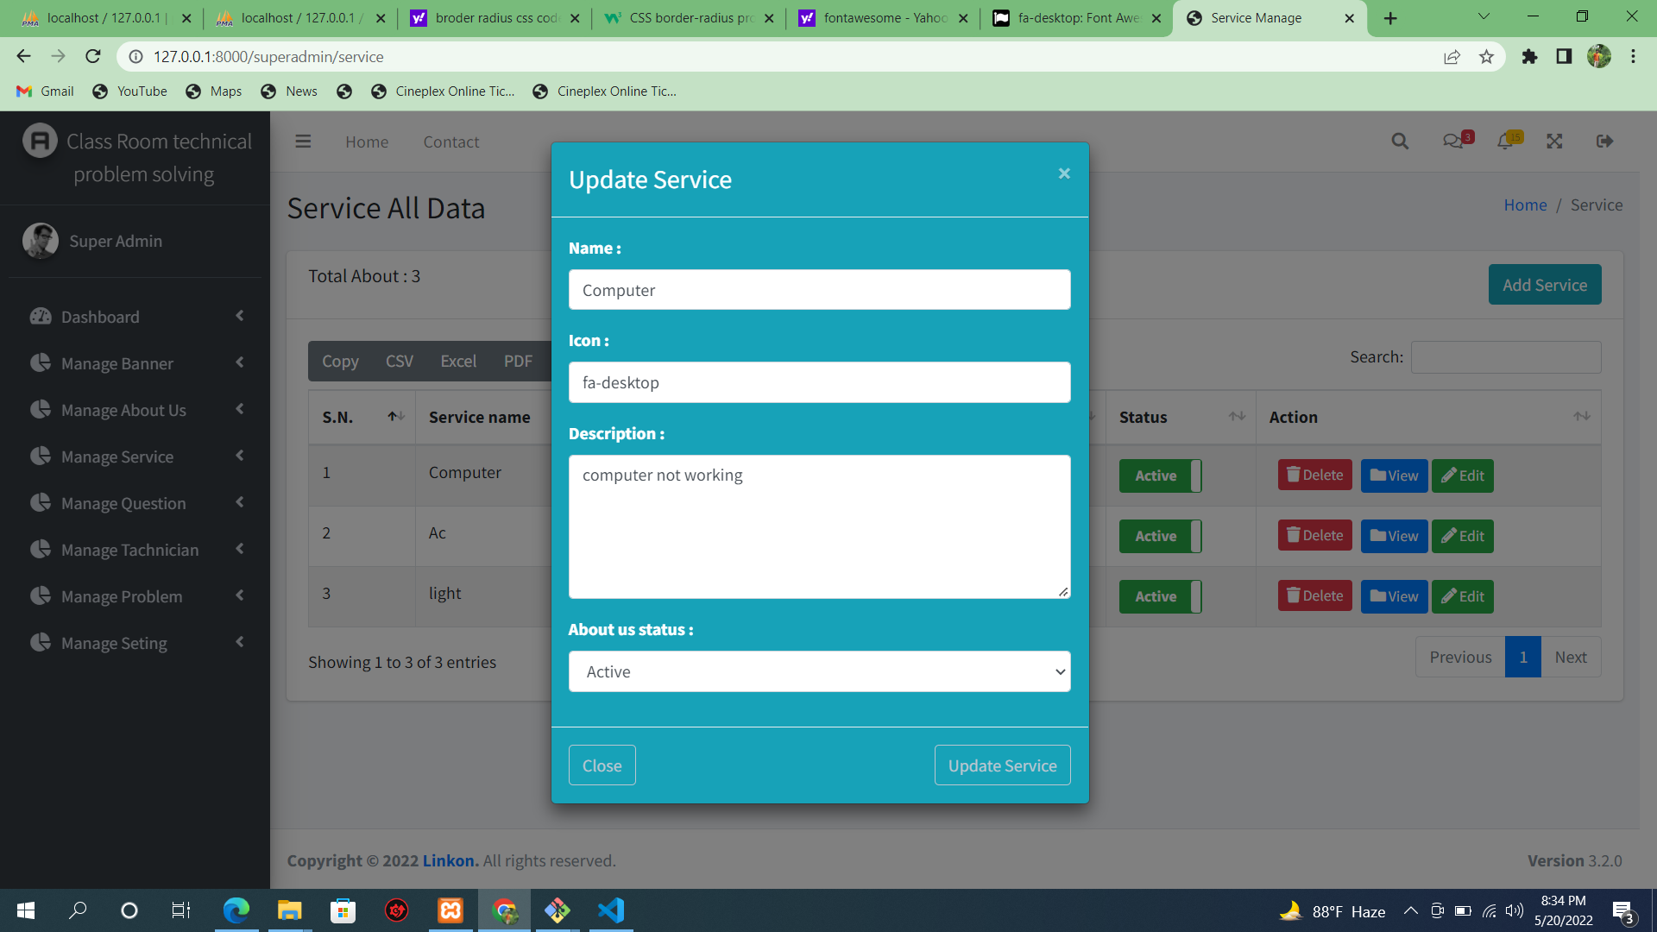

Slide 63
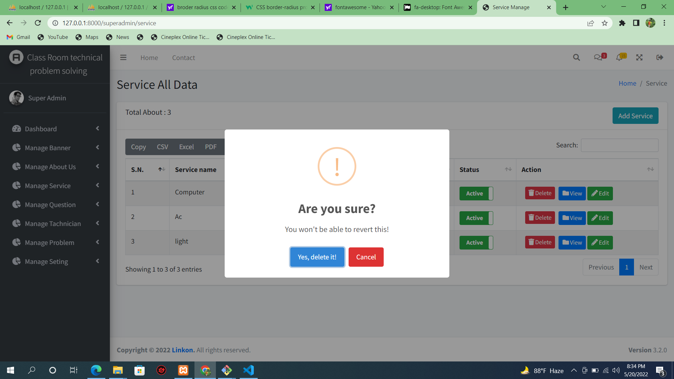

Slide 64
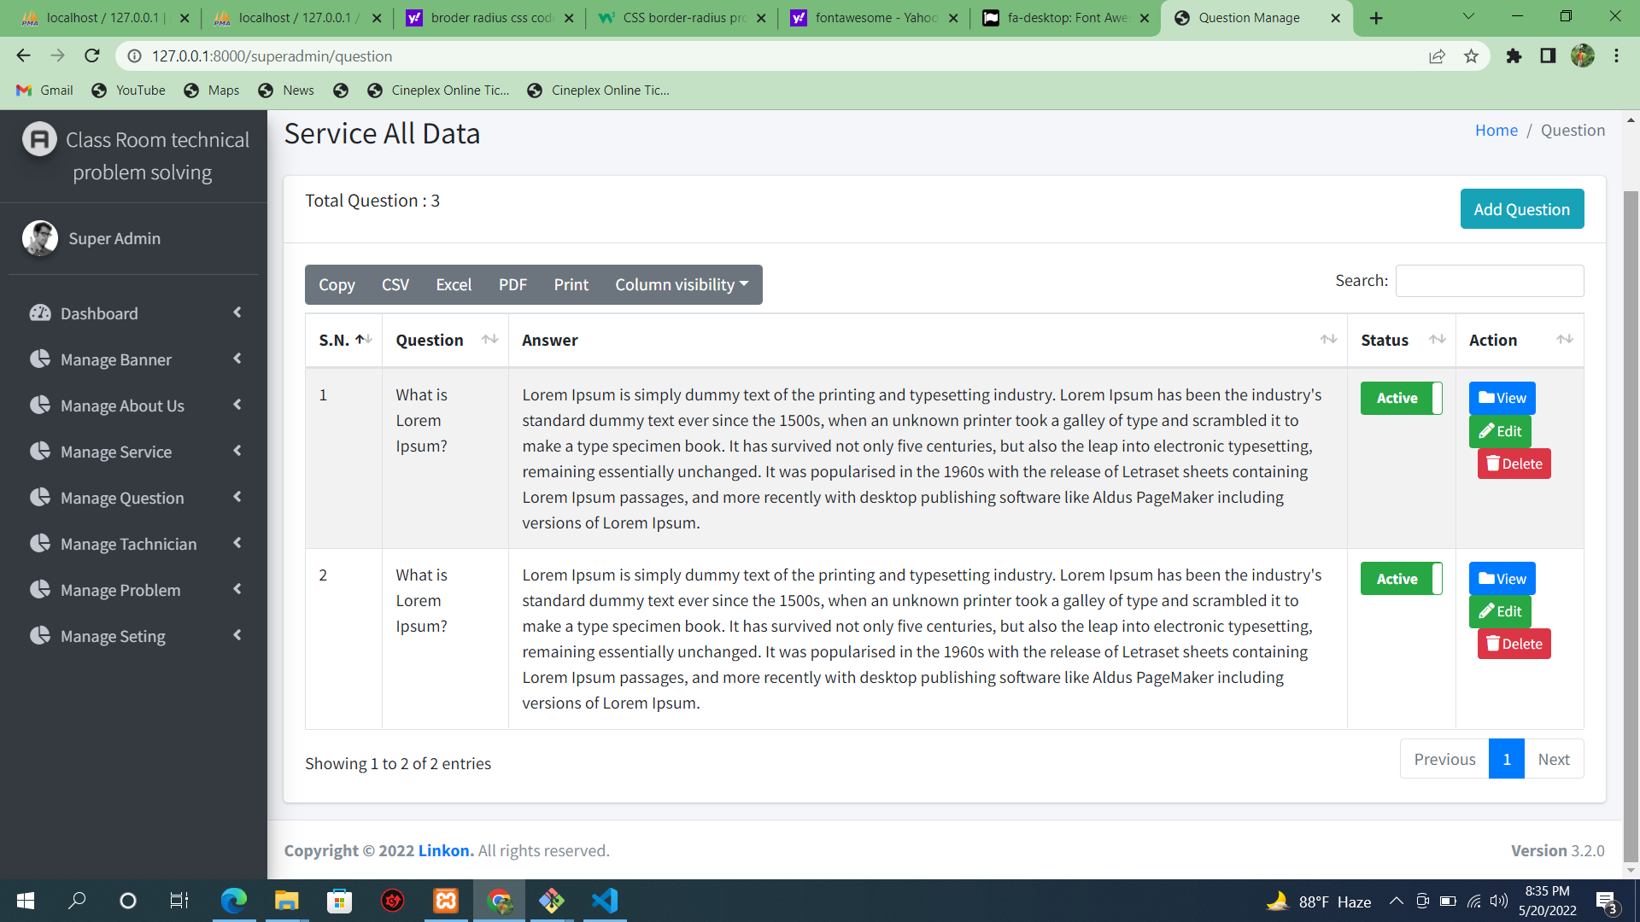

Slide 65
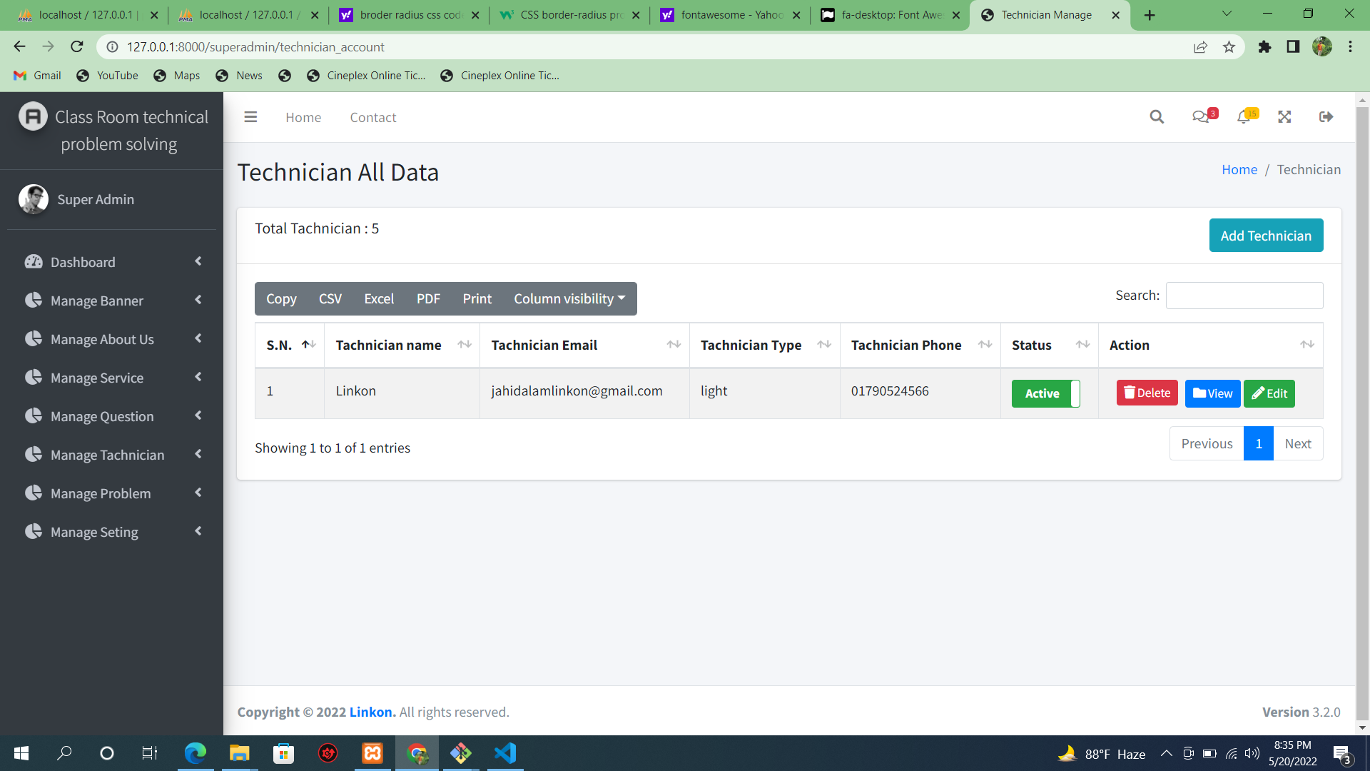

Slide 66


Slide 67


Slide 68
Thank You

